Slide 1
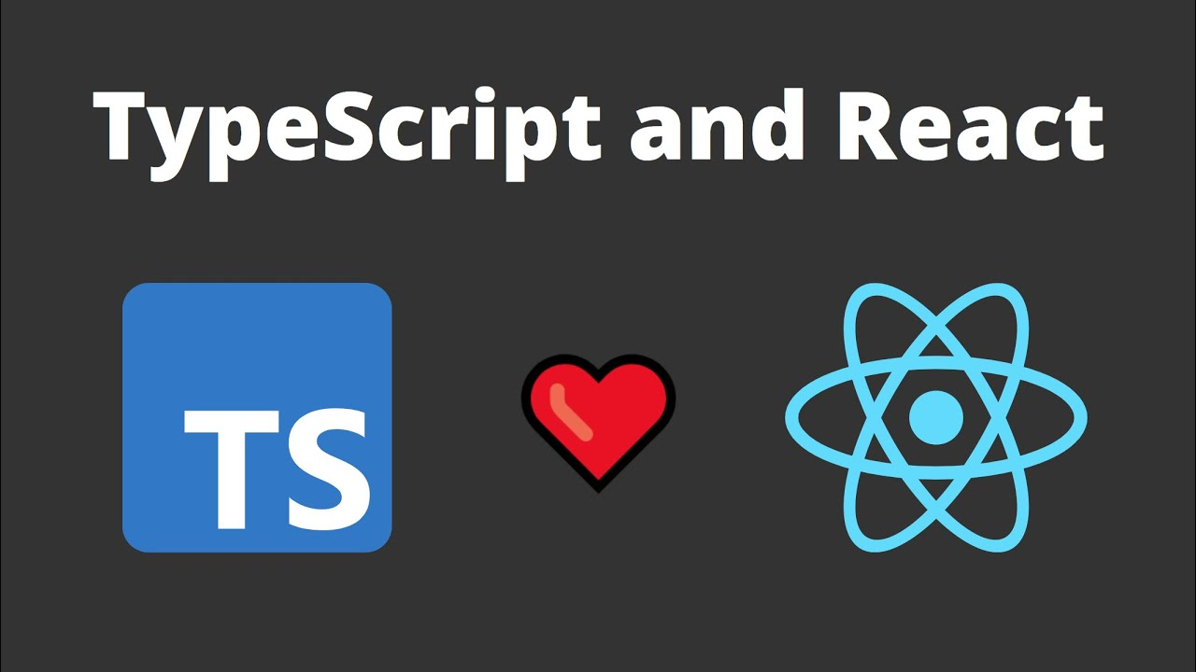

Slide 2
Topics will be covered in this lecture
Prerequisites
VS Code Extensions
Starter Kits
Cloud Setup
Local dev Setup
React Props
Types
Interfaces
Guidelines for using types and interfaces
Difference between types and interfaces
Function Components
Class Components
Typing default props
Forms and Events
Project: A Todo List App

Slide 3
Prerequisites
good understanding of React
familiarity with TypeScript Types
having read the TypeScript section in the official React docs.
having read the React section of the new TypeScript playground (optional: also step through the 40+ examples under the playground's Examples section)
VS Code Extensions
refactoring help https://marketplace.visualstudio.com/items?itemName=paulshen.paul-typescript-toolkit
R+TS Code Snippets (there are a few...)
https://marketplace.visualstudio.com/items?itemName=infeng.vscode-react-typescript
https://www.digitalocean.com/community/tutorials/the-best-react-extension-for-vs-code
TypeScript official extension https://code.visualstudio.com/docs/languages/typescript

Slide 4
React + TypeScript Starter Kits
Cloud setups:
TypeScript Playground with React just if you are debugging types (and reporting issues), not for running code
CodeSandbox - cloud IDE, boots up super fast
Stackblitz - cloud IDE, boots up super fast
Local dev setups:
Next.js: npx create-next-app -e with-typescript will create in your current folder
Create React App: npx create-react-app my-app --template typescript will create in new folder
Vite: npm create vite@latest my-app --template react-ts
Meteor: meteor create --typescript my-app
Ignite for React Native: ignite new myapp

Slide 5
React Props
Using types
Using interface
Types
Interface
type AppProps = {
message: string;
count: number;
disabled: boolean;
names: string[];
}
export interface TaskInterface {
id: number;
task: string;
isCompleted: boolean;
}

Slide 6
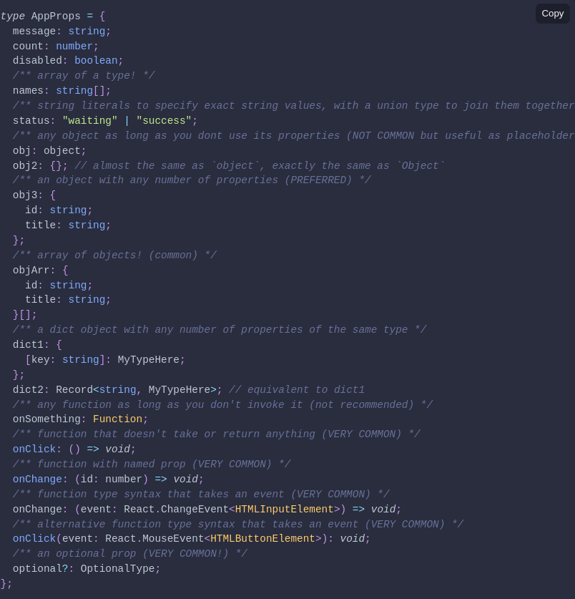
A list of TypeScript types you will likely use in a React+TypeScript app:

Slide 7
Types or Interfaces?
always use interface for public API's definition when authoring a library or 3rd party ambient type definitions, as this allows a consumer to extend them via declaration merging if some definitions are missing.
consider using type for your React Component Props and State, for consistency and because it is more constrained.
Types are useful for union types (type MyType = TypeA | TypeB) whereas Interfaces are better for declaring dictionary shapes and then implementing or extending them.

Slide 8
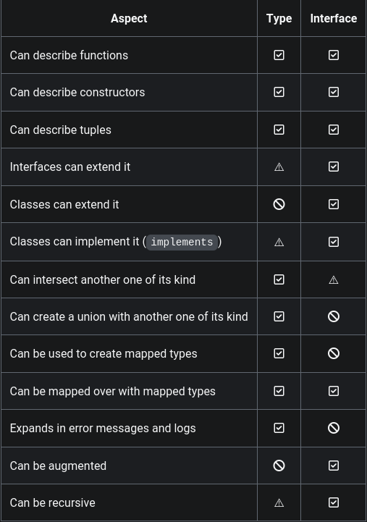

Useful table for Types vs Interfaces

Slide 9
Function Components
These can be written as normal functions that take a props argument and return a JSX element.
// Declaring type of props - see "Typing Component Props" for more examples
type AppProps = {
message: string;
}; /* use `interface` if exporting so that consumers can extend */
// Easiest way to declare a Function Component; return type is inferred.
const App = ({ message }: AppProps) => <div>{message}</div>;
// you can choose annotate the return type so an error is raised if you accidentally return some other type
const App = ({ message }: AppProps): JSX.Element => <div>{message}</div>;
// you can also inline the type declaration; eliminates naming the prop types, but looks repetitive
const App = ({ message }: { message: string }) => <div>{message}</div>;

Slide 10
Class Components
Within TypeScript, React.Component is a generic type (aka React.Component<PropType, StateType>), so you want to provide it with (optional) prop and state type parameters:
type MyProps = {
// using `interface` is also ok
message: string;
};
type MyState = {
count: number; // like this
};
class App extends React.Component<MyProps, MyState> {
state: MyState = {
// optional second annotation for better type inference
count: 0,
};
render() {
return (
<div>
{this.props.message} {this.state.count}
</div>
);
}
}

Slide 11
Class Methods: Do it like normal, but just remember any arguments for your functions also need to be typed:
class App extends React.Component<{ message: string }, { count: number }> {
state = { count: 0 };
render() {
return (
<div onClick={() => this.increment(1)}>
{this.props.message} {this.state.count}
</div>
);
}
increment = (amt: number) => {
// like this
this.setState((state) => ({
count: state.count + amt,
}));
};
}

Slide 12
Typing defaultProps
Function Components:
type GreetProps = { age?: number };
const Greet = ({ age = 21 }: GreetProps) => // etc
Class Components:
type GreetProps = {
age?: number;
};
class Greet extends React.Component<GreetProps> {
render() {
const { age = 21 } = this.props;
/*...*/
}
}
let el = <Greet age={3} />;

Slide 13
Forms and Events
type State = {
text: string;
};
class App extends React.Component<Props, State> {
state = {
text: "",
};
// typing on RIGHT hand side of =
onChange = (e: React.FormEvent<HTMLInputElement>): void => {
this.setState({ text: e.currentTarget.value });
};
render() {
return (
<div>
<input type="text" value={this.state.text} onChange={this.onChange} />
</div>
);
}
}

